Slide 1
Main Components
Rotor
Nacelle
Tower
Foundation

Slide 2
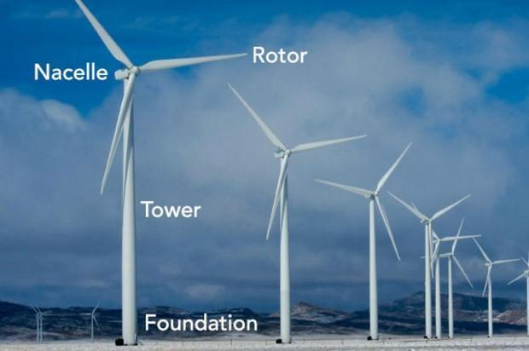

Slide 3
Rotor
Generates Aerodynamic Torque from the Wind
The rotor converts the energy contained in the wind in rotational movement so as bigger the area, bigger power output in the same wind conditions.
Consists of: Hub Blades Spinner Pitch bearing and system

Slide 4
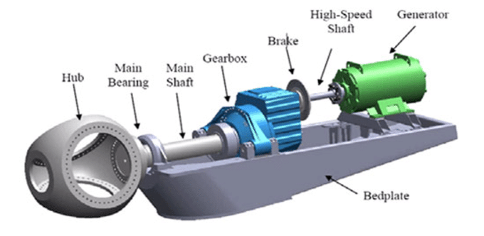
Nacelle with drivetrain and power electronics

Slide 5
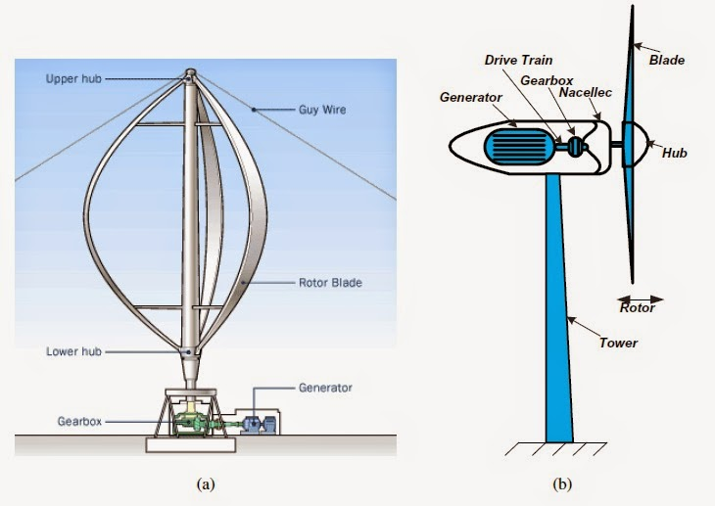

Slide 6
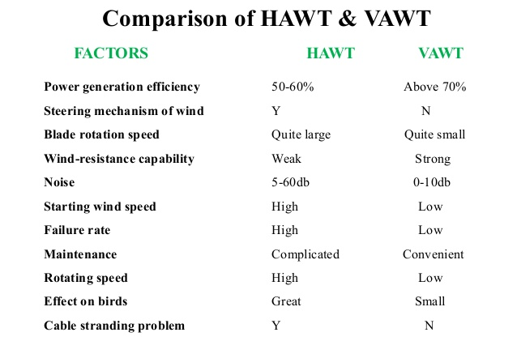

Slide 7
Vertical Axis Wind Turbine Aerodynamic Analysis

Slide 8
The wind turbine parameters considered in the design process are:
• Swept area
• Power and power coefficient
• Tip speed ratio
• Blade chord
• Number of blades
• Solidity
• Initial angle of attack

Slide 9
Swept area
The swept area is the section of air that encloses the turbine in its movement
The swept area limits the volume of air passing by the turbine.
the shape of the swept area depends on the rotor configuration where for HAWT is circular shaped while for VAWT is Rectangular shaped.
Swept Area calculated using: S=2RL where: S is the swept area [m2] R is the rotor radius [m] L is the blade length [m].

Slide 10
Power and power coefficient
The power available from wind for a vertical axis wind turbine can be found from the following formula: P_{w} = ½ S ρ V_{o}³ where: Vo is the velocity of the wind [m/s] ρ is the air density [kg/m3 ], the reference density used its standard sea level value (1.225 kg/m^3 at 15ºC), for other values from the source (Aerospaceweb.org, 2005).

Slide 11
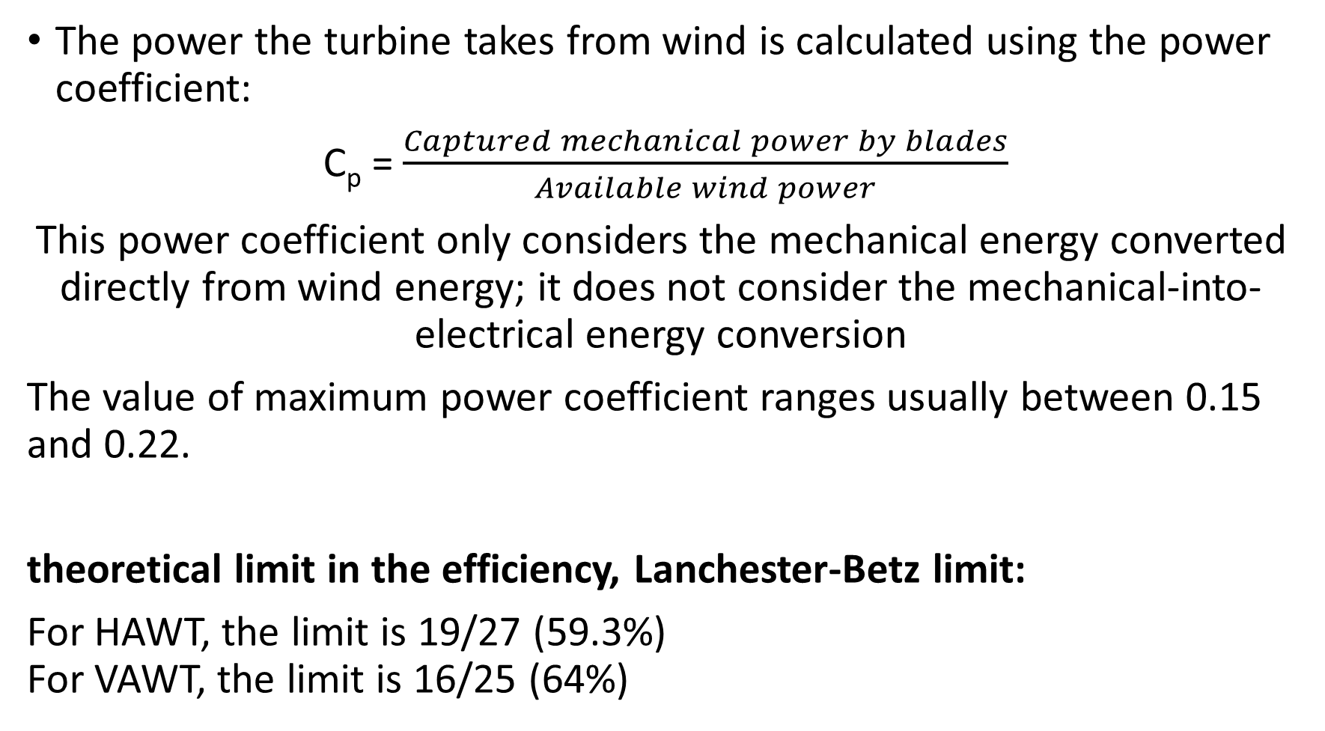
The power the turbine takes from wind is calculated using the power coefficient:
C_{p} = $\frac{Captured mechanical power by blades}{Available wind power}$
This power coefficient only considers the mechanical energy converted directly from wind energy; it does not consider the mechanical-into-electrical energy conversion
The value of maximum power coefficient ranges usually between 0.15 and 0.22.
theoretical limit in the efficiency, Lanchester-Betz limit:
For HAWT, the limit is 19/27 (59.3%) For VAWT, the limit is 16/25 (64%)

Slide 12
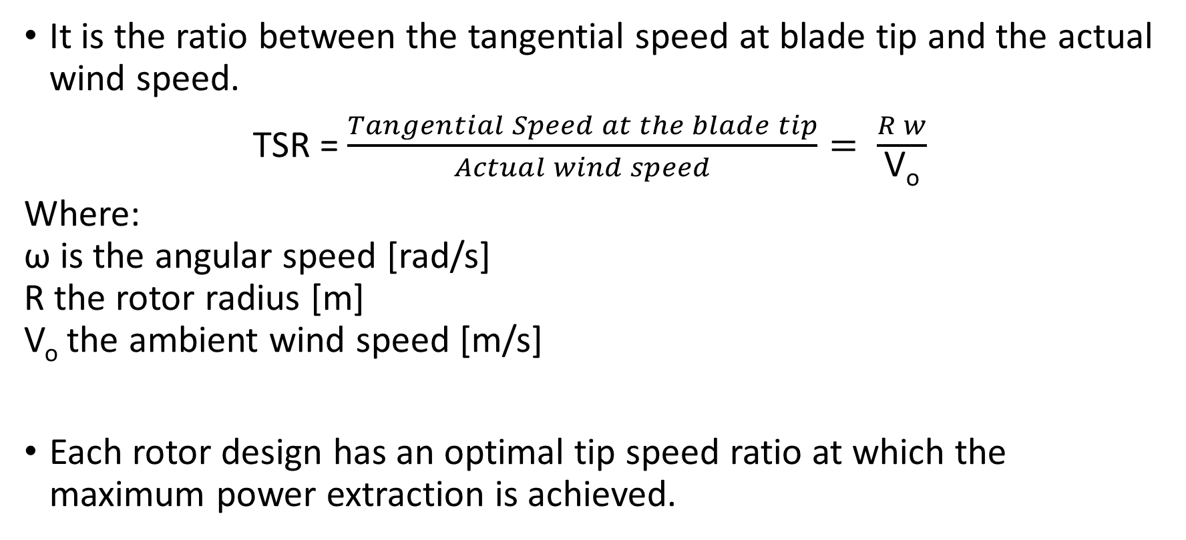
Tip Speed Ratio
It is the ratio between the tangential speed at blade tip and the actual wind speed.
TSR = $\frac{Tangential Speed at the blade tip}{Actual wind speed}= \frac{R w}{\text{V}\text{o}}$
Where: ω is the angular speed [rad/s] R the rotor radius [m] V_{o} the ambient wind speed [m/s]
Each rotor design has an optimal tip speed ratio at which the maximum power extraction is achieved.

Slide 13
Blade chord
The chord is the length between leading edge and trailing edge of the blade profile. The blade thickness and shape is determined by the airfoil used, in this case it will be a NACA airfoil, where the blade curvature and maximum thickness are defined as percentage of the chord.

Slide 14
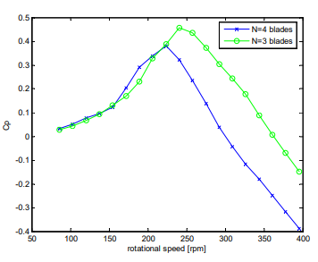
Number of blades
three blades are more efficient than four for the same rotational speed; the final decision will be made considering the acceleration behavior, which will provide a better view of the self-starting characteristics.

Slide 15
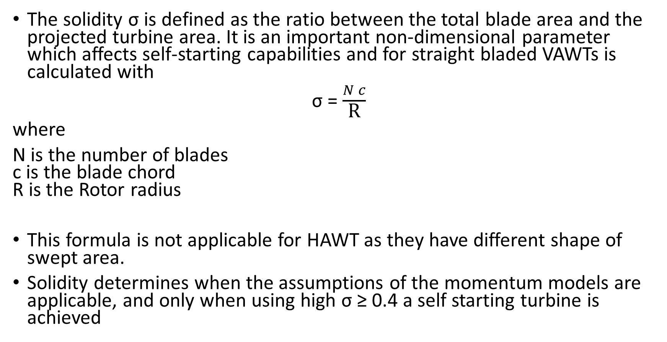
Solidity
The solidity σ is defined as the ratio between the total blade area and the projected turbine area. It is an important non-dimensional parameter which affects self-starting capabilities and for straight bladed VAWTs is calculated with
σ = $\frac{N c}{\text{R}}$
where
N is the number of blades c is the blade chord R is the Rotor radius
This formula is not applicable for HAWT as they have different shape of swept area.
Solidity determines when the assumptions of the momentum models are applicable, and only when using high σ ≥ 0.4 a self starting turbine is achieved

Slide 16
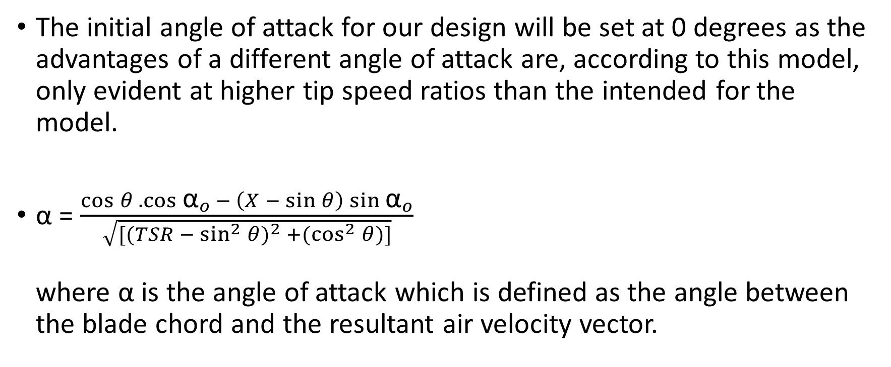
Initial angle of attack
The initial angle of attack for our design will be set at 0 degrees as the advantages of a different angle of attack are, according to this model, only evident at higher tip speed ratios than the intended for the model.
α = $\frac{\cos{θ . \cos{{\text{α}}_{o} − \left(X − \sin{θ}\right)\sin{{\text{α}}_{o}}}}}{\sqrt{{[(TSR − \sin^{2}{θ})}^{2} +(\cos^{2}{θ})]}}$ where α is the angle of attack which is defined as the angle between the blade chord and the resultant air velocity vector.

Slide 17
In order to speed up the optimization process, some of the parameters have to be fixed for our purposes. The fixed parameters will be the design airspeed and the blade swept area.
Since Power Coefficient C_{p} is between 0.15 and 0.2, so Swept area is between 4 and 5.2 m² to get 100 W at 6 m/s.
Swept area selected is 4 m²
Design air speed is kept at 6 m/s, as the purpose is to take profit of average wind speed rather than higher speeds.

Slide 18
The starting parameters and conditions in which the wind turbine has been tested are
Symbols | Parameter | Starting Value
V_{o} | Air speed | 6 m/s
TSR | Tip speed Ratio | 2
R | Rotor Radius | 1 m
c | Blade chord | 0.3 m
L | Blade length | 2 m
n | Number of Blades | 4
α_{o} | Initial angle of attack | 0⁰

Slide 19
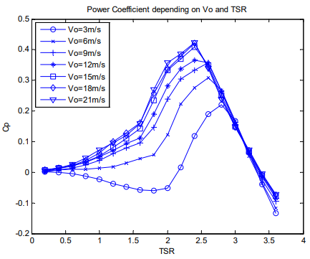

Slide 20
